Slide 1
Advanced Access Control in GraphQL APIs
Group 4: Wilke Klausing, Huy Viet Nguyen

Slide 2
Structure
Access Control
Access Control Models
GraphQL
GraphQL vs REST
Our Task
Validation Use-Case

Slide 3
Access Control
Control and monitor access of resources
Allows or permits Read/Write/Delete operations
Subjects, Objects, and Access Rights
Implemented through different models

Slide 4
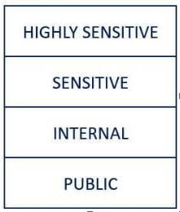
Access Control Models
Mandatory Access Control
Administration has authority
Discretionary Access Control
Creator has authority
Rule-Based Access Control
Grants access according to IF ELSE statements
Purpose-Based Access Control
Defines access to purposes

Slide 5
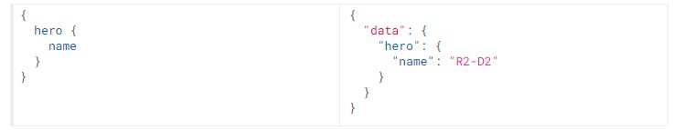
GraphQL
Query language and server-side runtime
Queries similar to JSON
Resolver for each requested field

Slide 6
GraphQL vs REST
REST uses several endpoints
Overfetching
Underfetching

Slide 7
Our task
Create a re-usable component for at least one widely used framework/stack for developing GraphQL Web APIs allowing developers to easily add access control to their APIs
Minimum requirement: access-control on a field/parameter basis and at least one advanced access control scheme

Slide 8
Access Control Component
Functionality:
Rule-Based Access Control (basic)
Purpose-Based Access Control (advanced)
more if we have enough time available

Slide 9
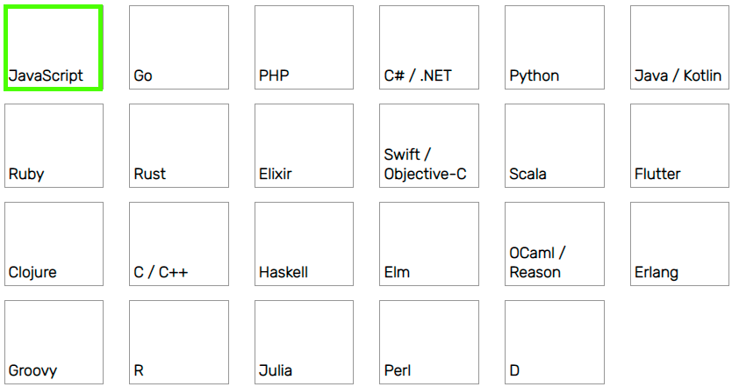
Our Thought Process
What languages
does GraphQL
support?

Slide 10
Our Thought Process
2. What are the most used JavaScript Frameworks?
GraphQL.js
Apollo Server
Express GraphQL

Slide 11
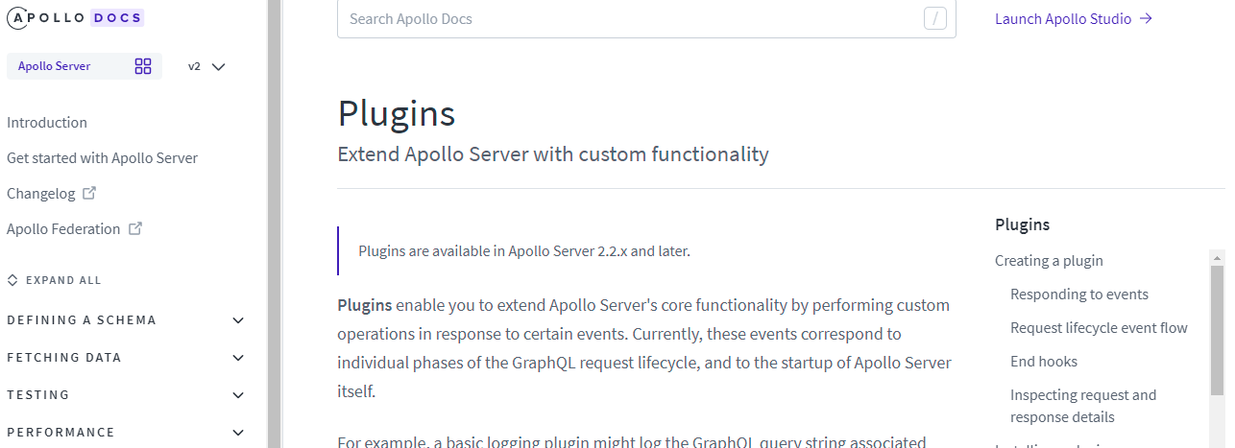
Our Thought Process
Game Changer:

Slide 12
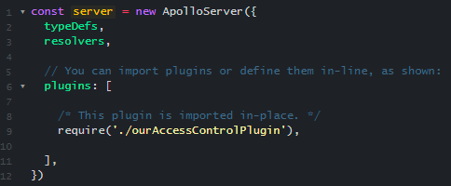
Access Control Plugin
System Integration:

Slide 13
Access Control Plugin
Configuration:
No database, only two configuration files:
Purpose tree as configuration file
Rules as configuration file
Goal:
Flexible
Reuseable
Developer Friendly

Slide 14
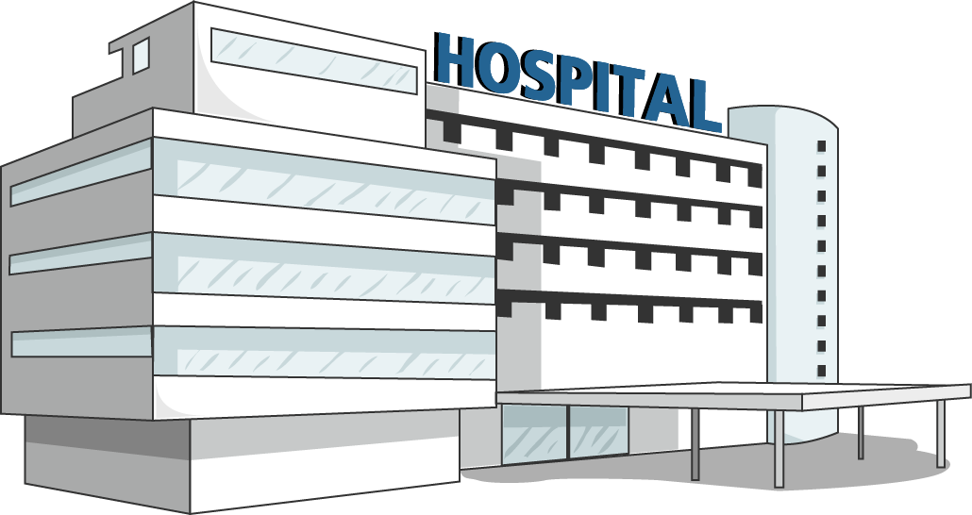
Validation Use-Case

Slide 15
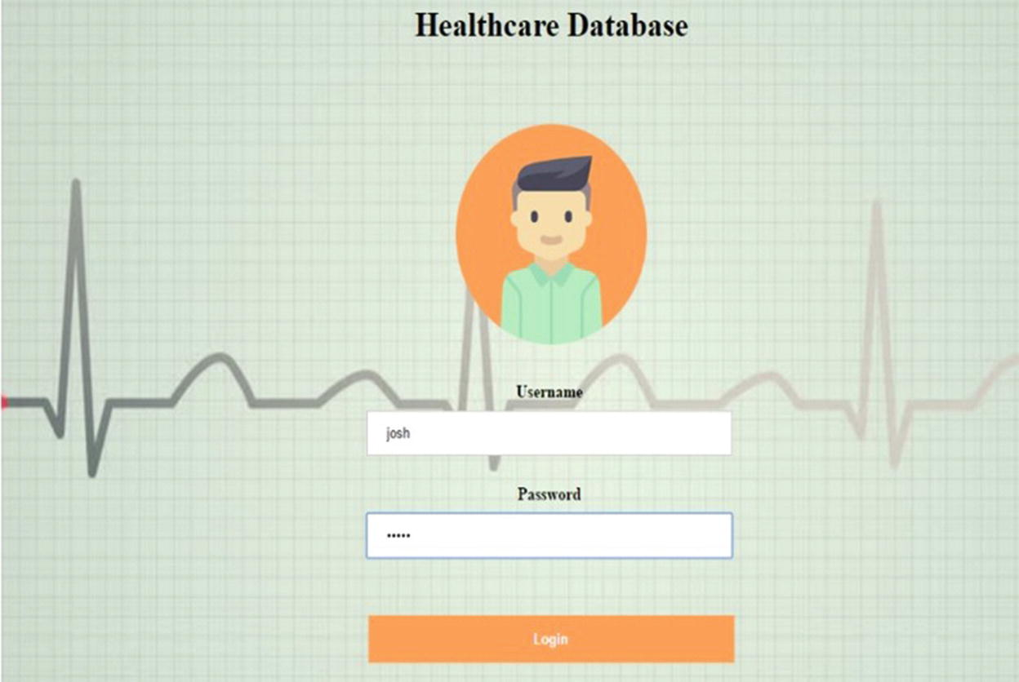
Validation Use-Case

Slide 16
Validation Use-Case:
Reasons to share health data:
Avoid medication errors
Avoid duplicate testing
Genetic studies
Chronic disease registries
Substance abuse
Population health management
Larger scale analytics
Epidemiology/disease tracking

Slide 17
Thank you for your attention.

